Slide 1
Kinergy Applications

Slide 2
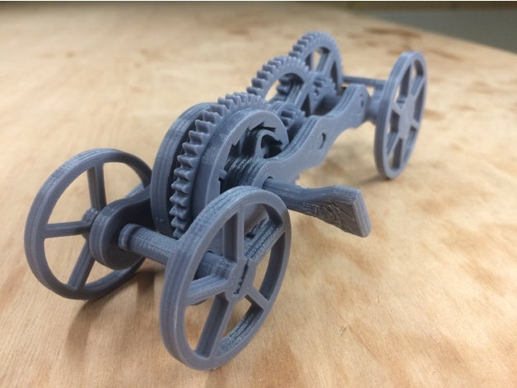
#1 Pull-back Car with Lock
Print out 3 cars with different motion parameters
for comparison.
Kinetic unit demonstration:
continuous linear moving (by twisting)

Slide 3
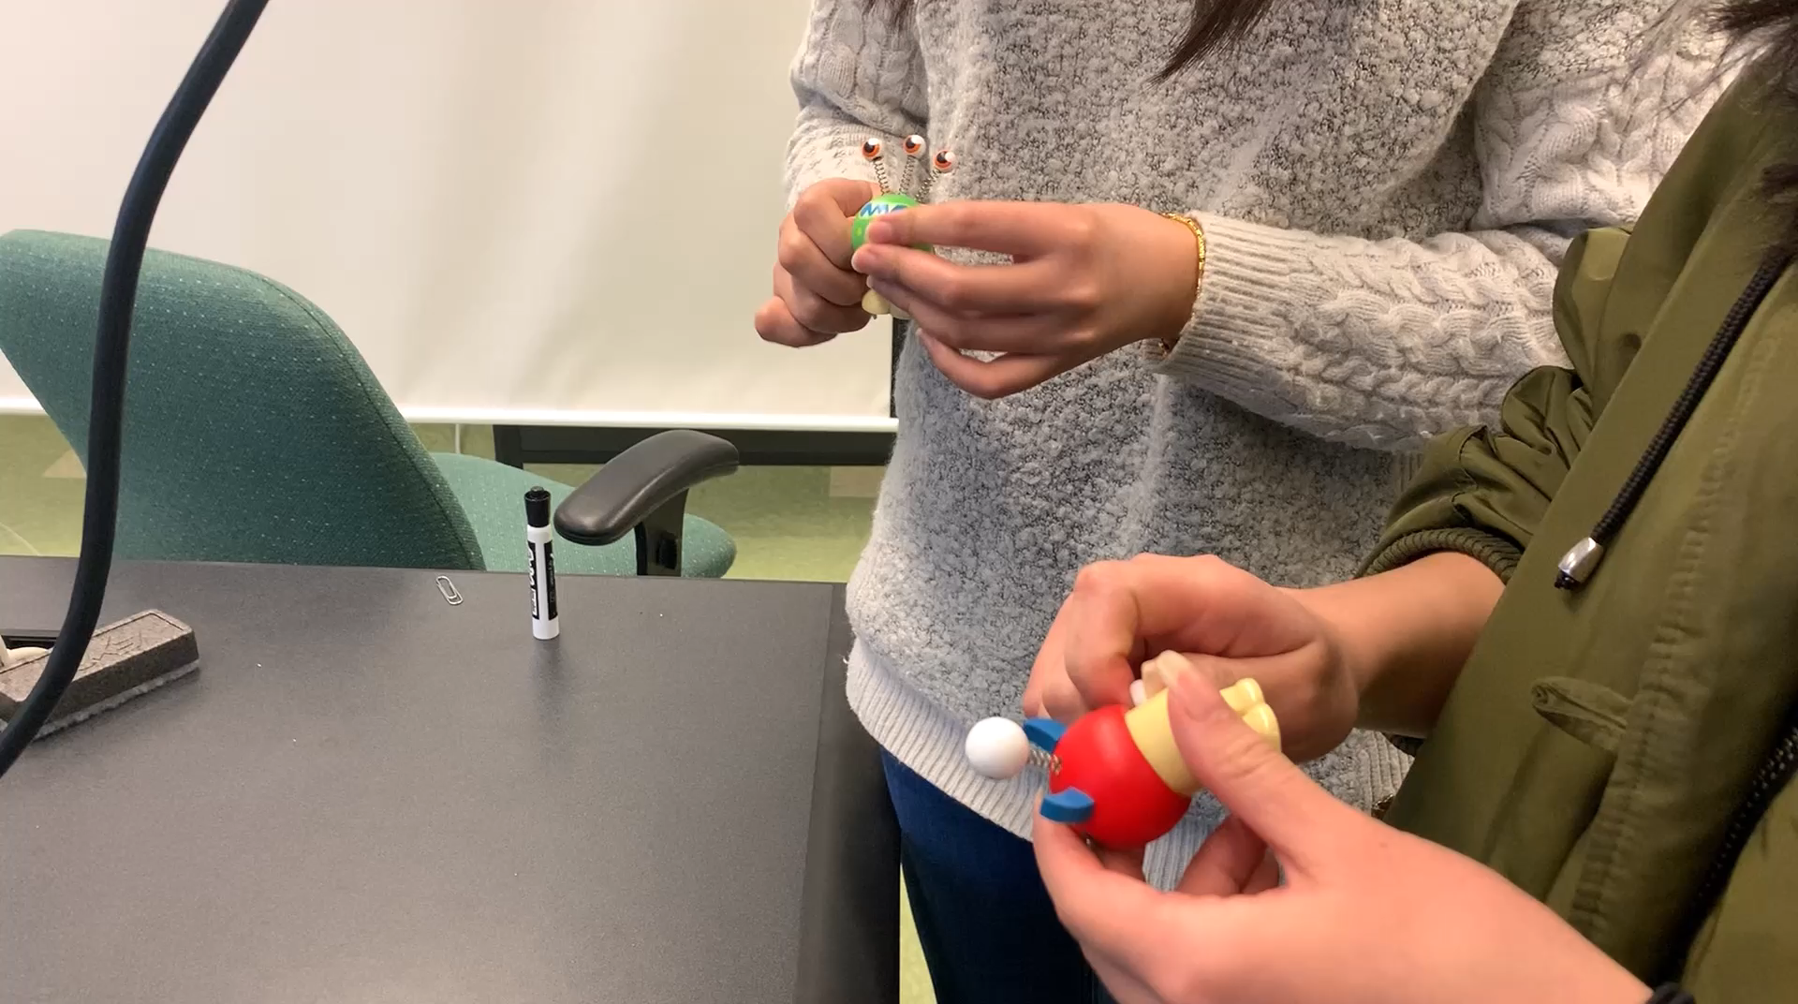
#2 Self-waking toy/robot
Could be modified for pressing to trigger the motion.
Kinetic unit demonstration:
intermittent hopping

Slide 4
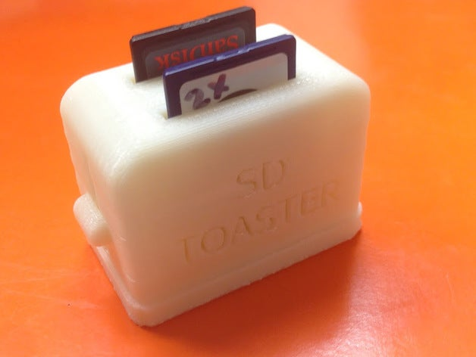
#3 Micro-SD card holder
A retro-design of the holder for the micro-SD card helps
the user easily insert and get out the card in the slot of a
machine such as a laptop or a 3D printer.
Kinetic unit demonstration:
Instant extension

Slide 5
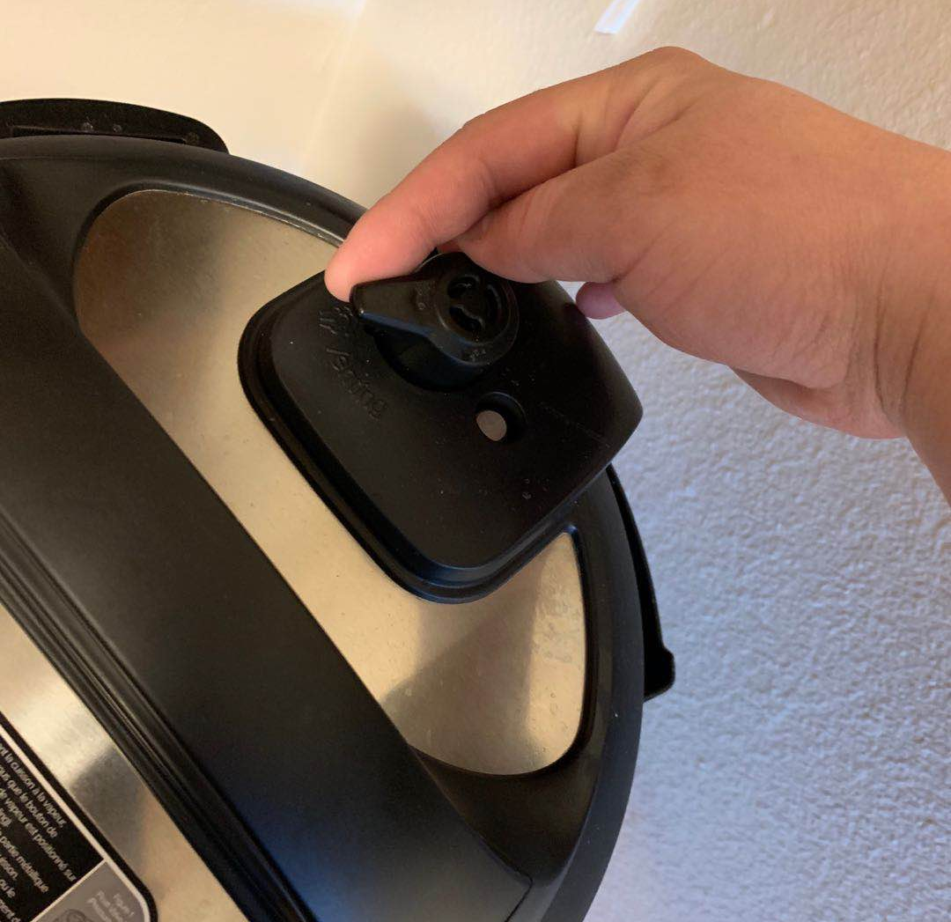
#4 Safety valve turner
An accessory/gadget turns the safety value for venting steam
out from a pot and protects the user from getting burned by
the hot steam.
Steam
Kinetic unit demonstration:
Instant turning

Slide 6
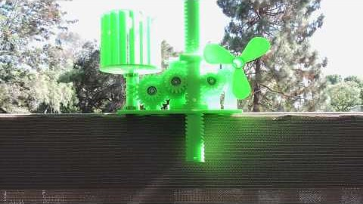
#5 Fan
This could be simplified into an all-in-one device.
Kinetic unit demonstration:
Continuous spinning by pressing

Slide 7
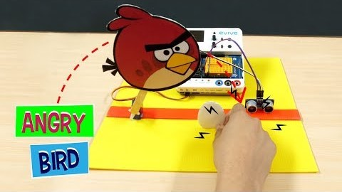
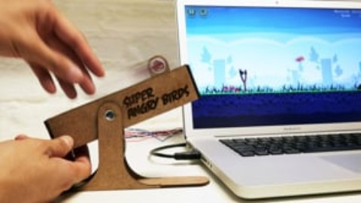
#6 *Catapult/Interactive Gadget for Game
Customize a catapult-like gadget as a game input
gadget that allows the player to interact with the
digital game on a iPad through physical devices.
Kinetic unit demonstration:
Instant throwing

Slide 8
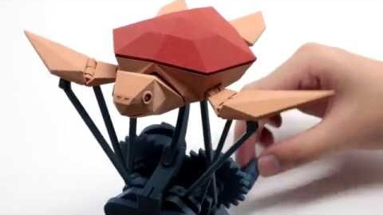
#7 Kinetic sculpture (art)
Kinetic unit demonstration:
Reciprocal moving

Slide 9
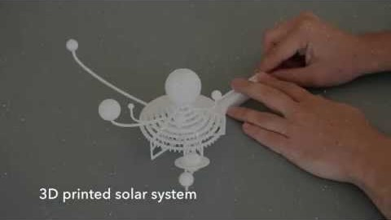
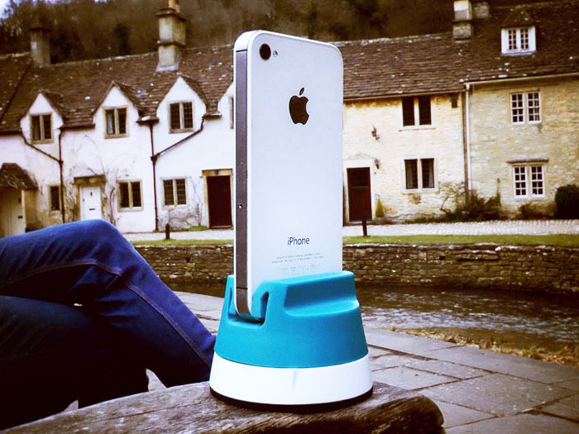
#9 Kitchen Timer and more
Maybe simplify the solar system to an earth-moon system.
Kinetic unit demonstration:
Rotatory motion by twisting design
Phone-cam rotator (360 degree shooting)

Slide 10
#5 A more complex rocket launcher?
Kinetic unit demonstration:
Bouncing design

Slide 11
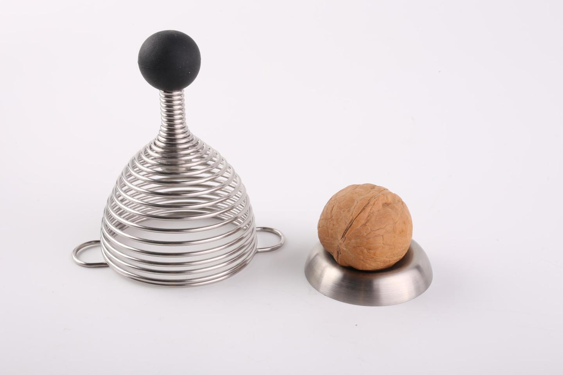
#6 Accessibility
Kinetic unit demonstration:
Spinning
Linear motion by twisting

Slide 12
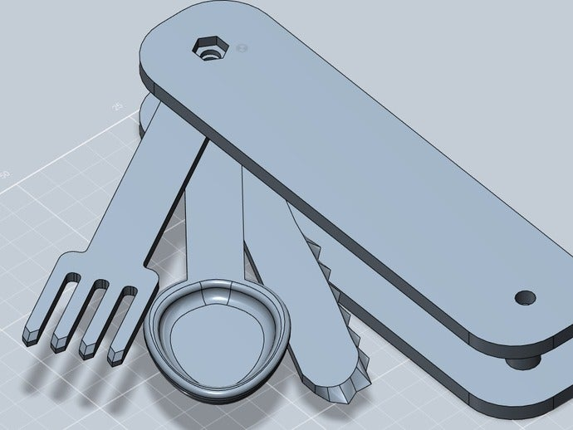
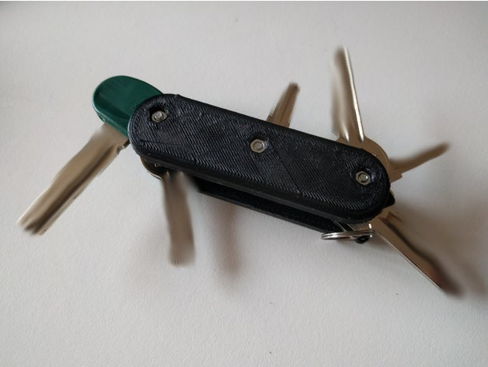
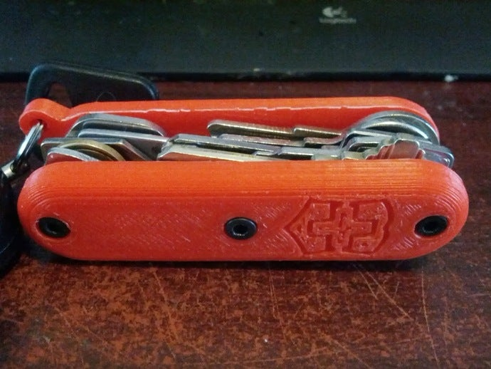
#10 Swiss Knife (key chain)
Kinetic unit demonstration:
Basic spinning design

Slide 13
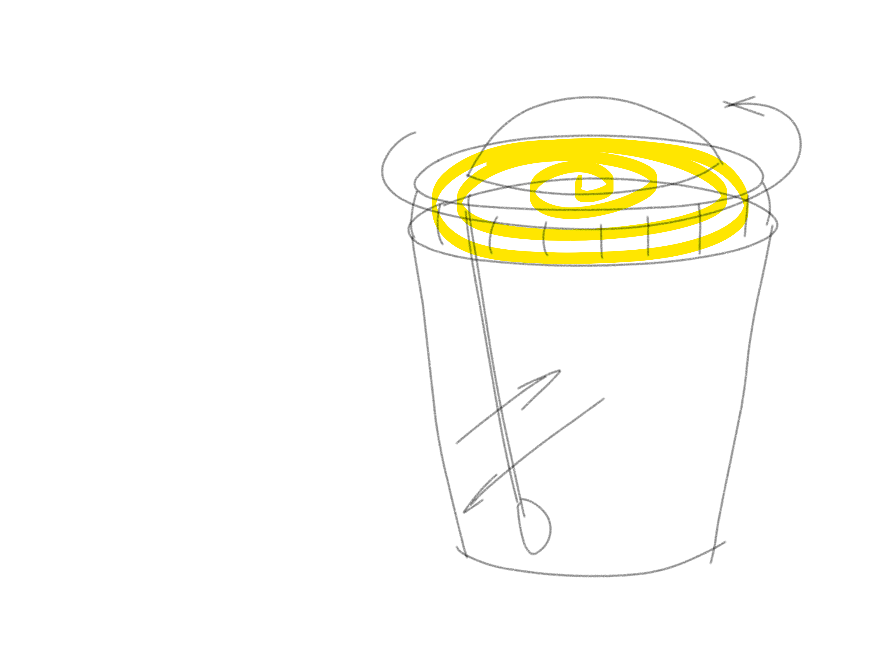
#11 Stirring Bottle
Kinetic unit demonstration:
Reciprocal Linear Motion

